Slide 1
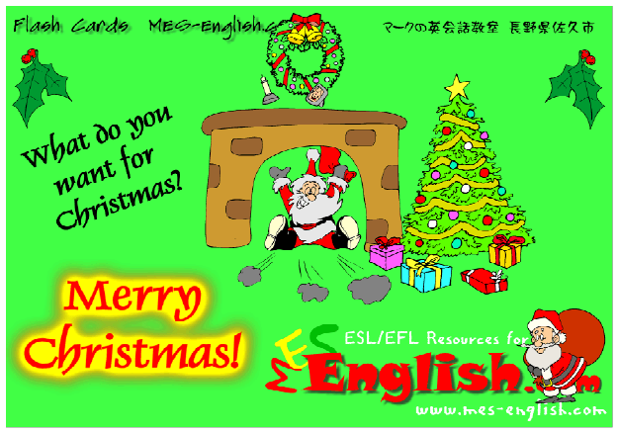
Copyright © 2005 – 2006 MES-English.com

Slide 2
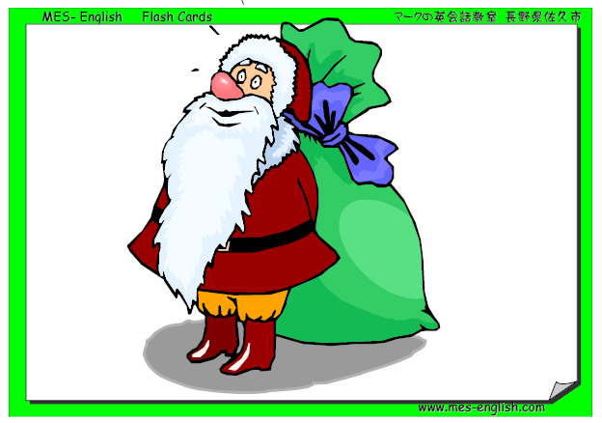
Santa – Father Christmas

Slide 3
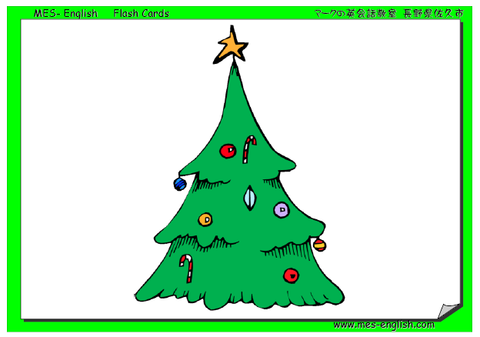
Christmas tree

Slide 4
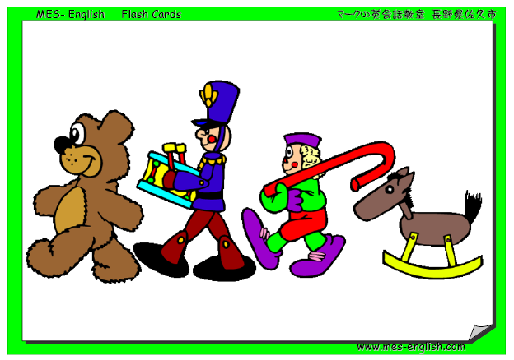
Toys

Slide 5
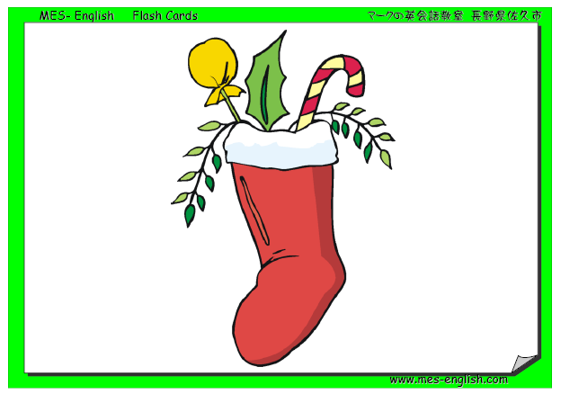
Stocking

Slide 6
Christmas Presents/Gifts

Slide 7
Candy Cane

Slide 8
Reindeer

Slide 9
Sleigh

Slide 10
Snowman

Slide 11
Christmas Lights

Slide 12
Bell

Slide 13
Angel

Slide 14
Elf

Slide 15
Bow

Slide 16
Mistletoe

Slide 17
Holly

Slide 18
Chimney

Slide 19
North Pole

Slide 20
Wreath

Slide 21
Decoration

Slide 22
Decorate the Tree

Slide 23
Candle

Slide 24
Fireplace

Slide 25
Nativity Scene

Slide 26
The Three Wise Men

